Slide 1

English
This presentation is automatically generated.
You can freely edit it and add any extra content you wish.
Español
Esta presentación se genera automáticamente.
Puedes modificarla a tu criterio y añadir cualquier contenido adicional que desees.
Italiano
Questa presentazione è generata automaticamente.
Puoi modificarla liberamente e aggiungere eventuali contenuti extra che desideri.

Slide 2
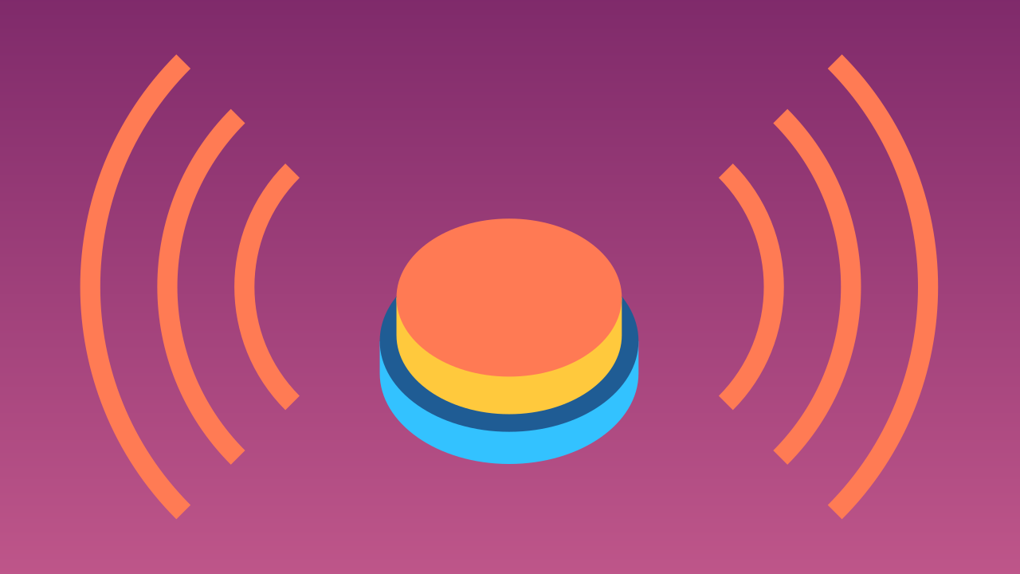
A Smarter Alarm with Events
Discover a more efficient way to code! Learn how events let your program react instantly to actions like a button press.

Slide 3
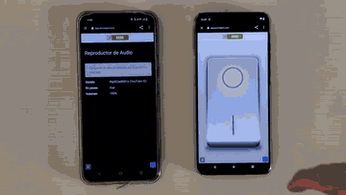
What will we do?

Slide 4

How does a switch work?
We are going to create an alarm that is activated by a switch. But to do that, we need to understand how a switch thinks.
In programming, a simple switch has two possible states:
On: The switch is activated. We can represent this state with the number 1.
Off: The switch is deactivated. We can represent this with the number 0.
A switch can only be in one state at a time. By reading whether the state is 1 or 0, the computer can decide what to do next.

Slide 5

How does the computer know the state?
The computer can be programmed to "listen" for a signal from the switch.
Every time the button's state changes (from Off to On, or On to Off), it notifies the computer!
This notification is called an event. Once the computer receives the event, it can run a specific piece of code to react to it.

Slide 6
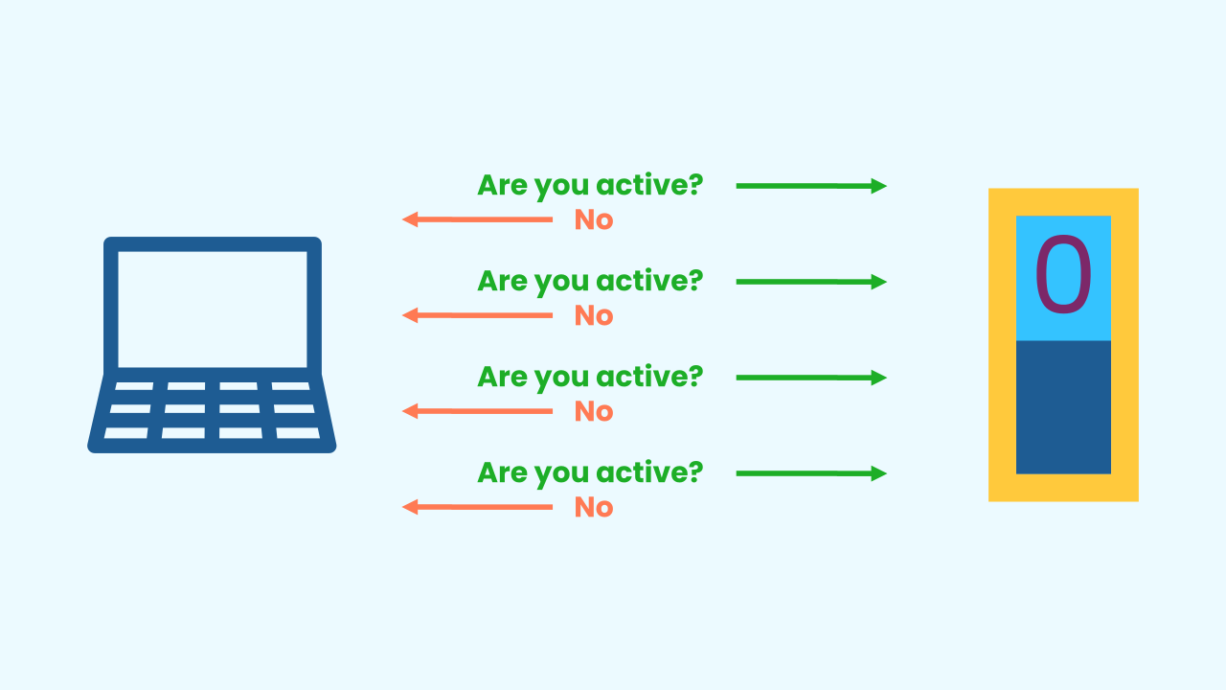
Why not just use a main loop?
Using a Main Loop to check a button is like a backseat driver constantly asking: *“Are you pressed yet?! How about now?! Are you pressed now?!”* even when nothing is happening. It's repetitive and wastes the computer's energy.
With events, the program is quiet. It just waits. The switch itself sends a single signal to the computer *only when its state has changed*. This is much more efficient and professional!

Slide 7
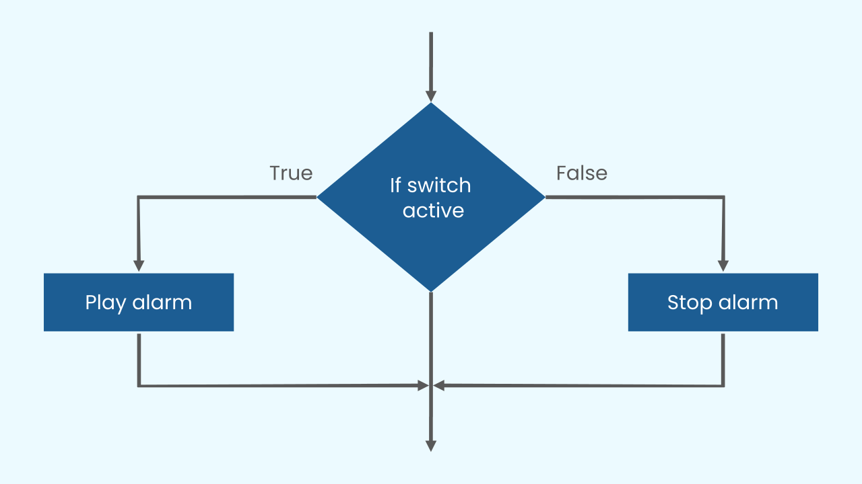
We received the event… Now what?
Once the switch sends its signal, the computer can use a conditional to decide what to do based on the switch’s current state.
For our alarm, the logic is simple: IF the switch's new state is ON, we play a sound. ELSE (meaning its new state is OFF), we stop the sound.

Slide 8
Make the Alarm
Let’s create a prototype that sounds an alarm when a switch is activated.
Press Add device and select AudioPlayer.
Press Add Device again and select Switch.
Remember that if you don’t have a smartphone to scan the QR codes, you can click Open in this window.

Slide 9
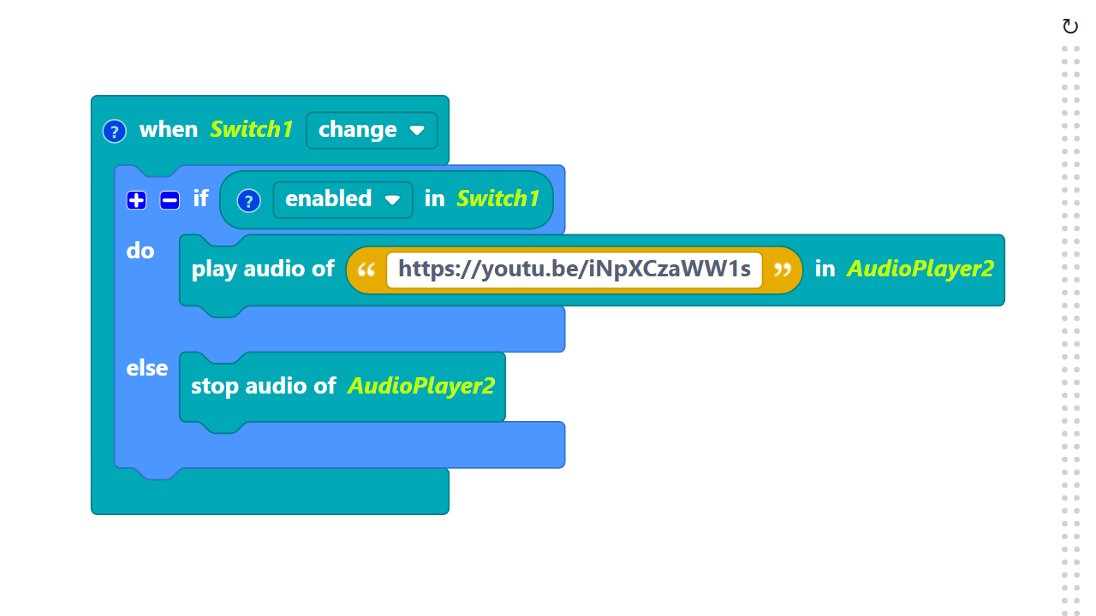
Code Composition
Click on the question mark icon to open the comments that explain the code.
https://app.protobject.com/generate?a10-alarmswitch&en&dynamic&-1

Slide 10
Reflect
Events are the backbone of all modern user interfaces—every click, tap, and swipe is an event.
*Besides buttons, what other things on your phone or in a game could trigger an event? (Think about notifications, finishing a download, a character touching a coin, etc.)*

