Slide 1

English
This presentation is automatically generated.
You can freely edit it and add any extra content you wish.
Español
Esta presentación se genera automáticamente.
Puedes modificarla a tu criterio y añadir cualquier contenido adicional que desees.
Italiano
Questa presentazione è generata automaticamente.
Puoi modificarla liberamente e aggiungere eventuali contenuti extra che desideri.

Slide 2
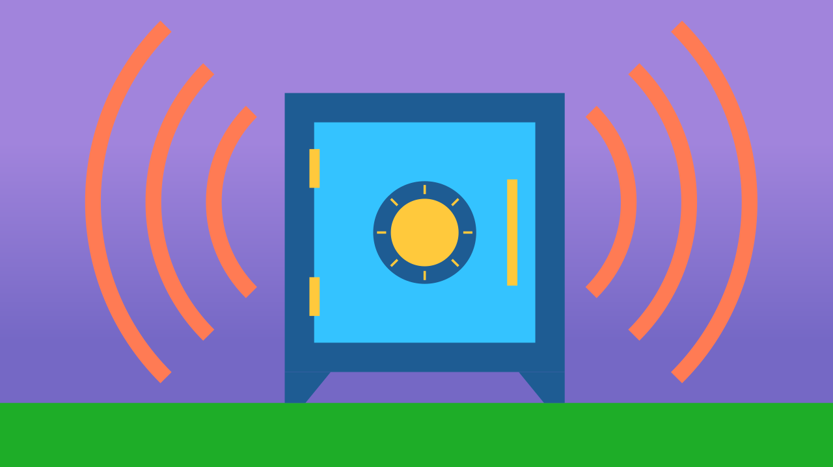
The Two-Key Safe Box
Explore cybersecurity concepts and logical operators ('AND') to build a high-security alarm that requires two buttons to be pressed simultaneously.

Slide 3
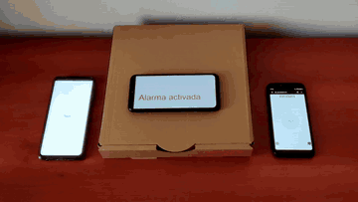
What will we do?

Slide 4

What is Cybersecurity?
Cybersecurity is like a digital shield. It's the practice of protecting computers, phones, and important data from malicious people online who want to steal or damage them. Just like you might have a lock on your diary or your room, your online accounts need protection too.

Slide 5
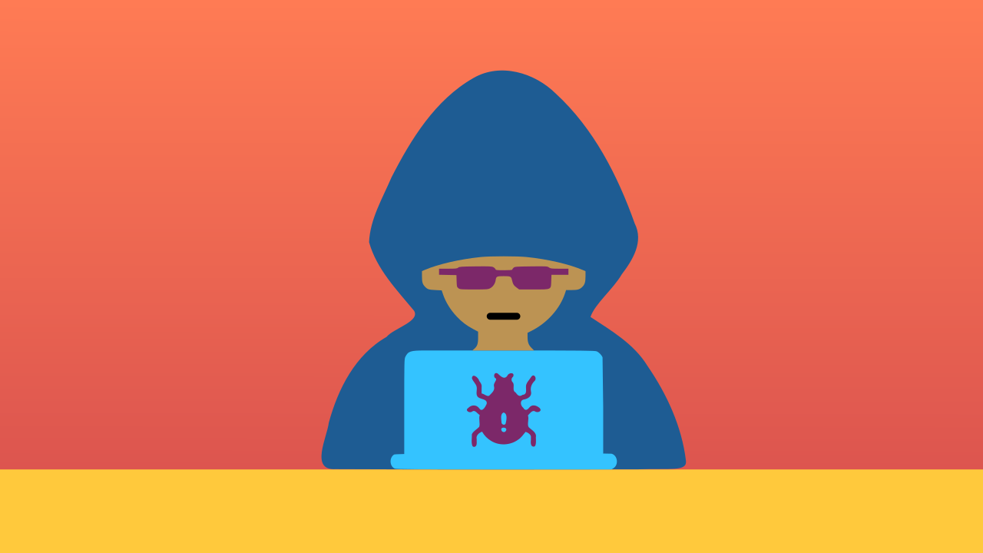
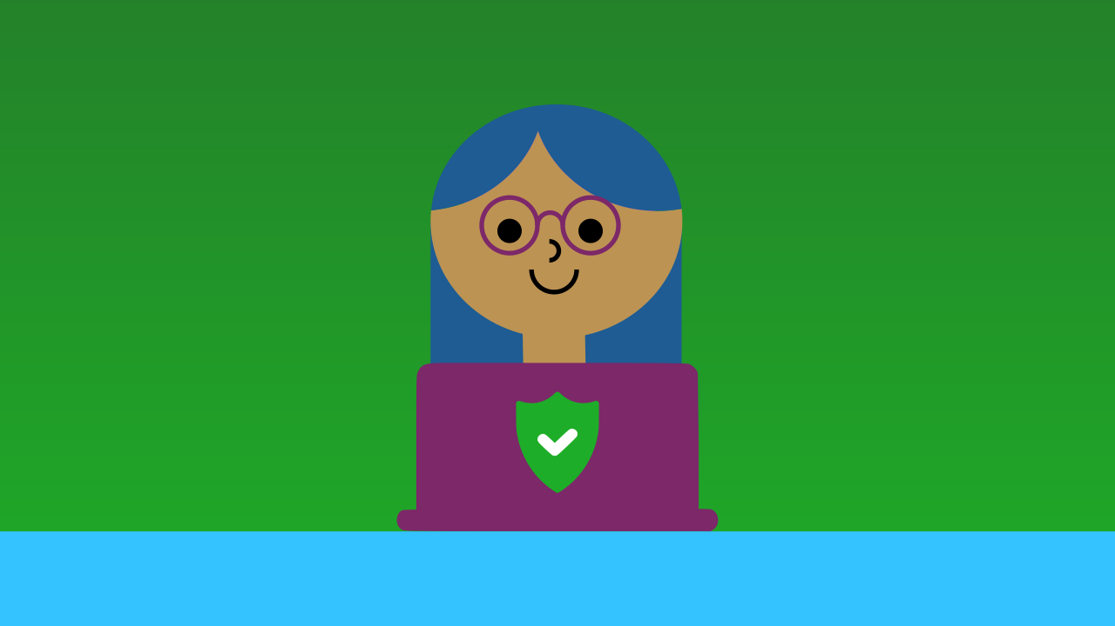
White Hats vs. Black Hats
On the internet, there are "Black Hats"—malicious hackers who use computer viruses and tricks to steal information. But there are also "White Hats"—cybersecurity experts who work to build defenses and protect data and systems from these attacks. They are the digital superheroes.

Slide 6
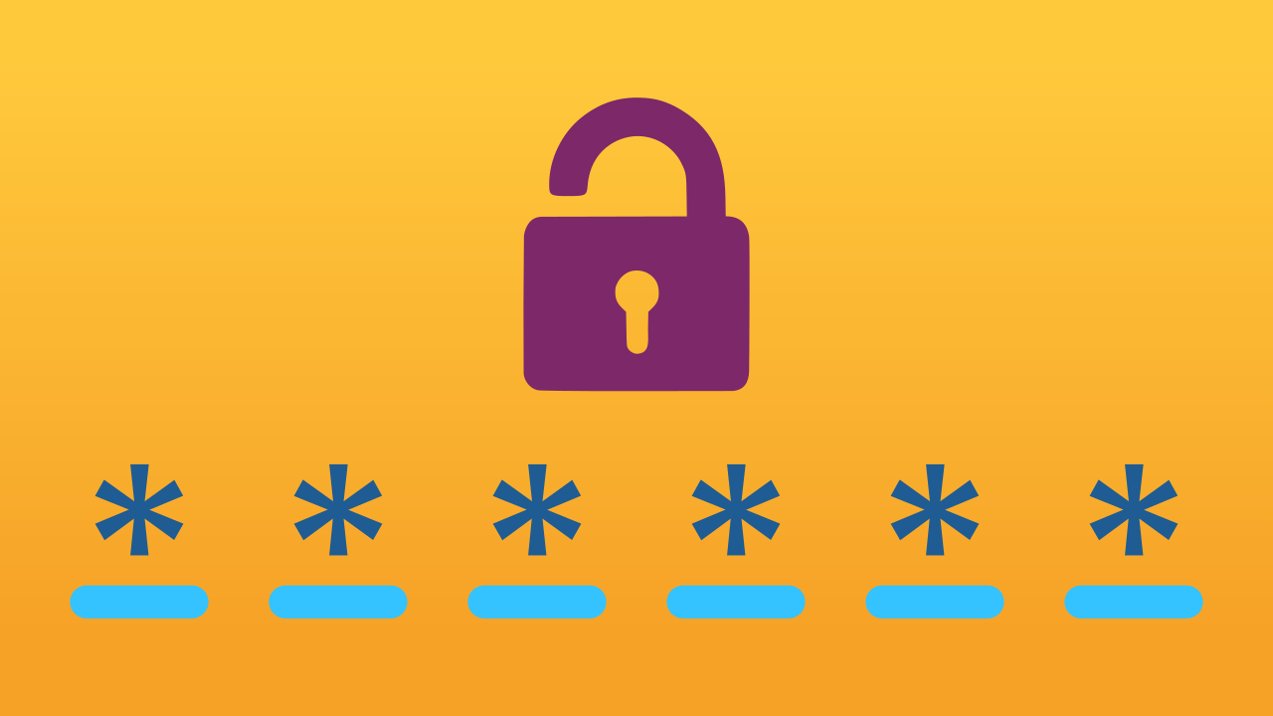
Your First Line of Defense: Passwords
One of the best ways to protect yourself is by using strong, unique passwords. A strong password is one that nobody can easily guess. If your password is too simple, like "123456" or "password," someone could easily break into your "digital safe" without your permission.

Slide 7
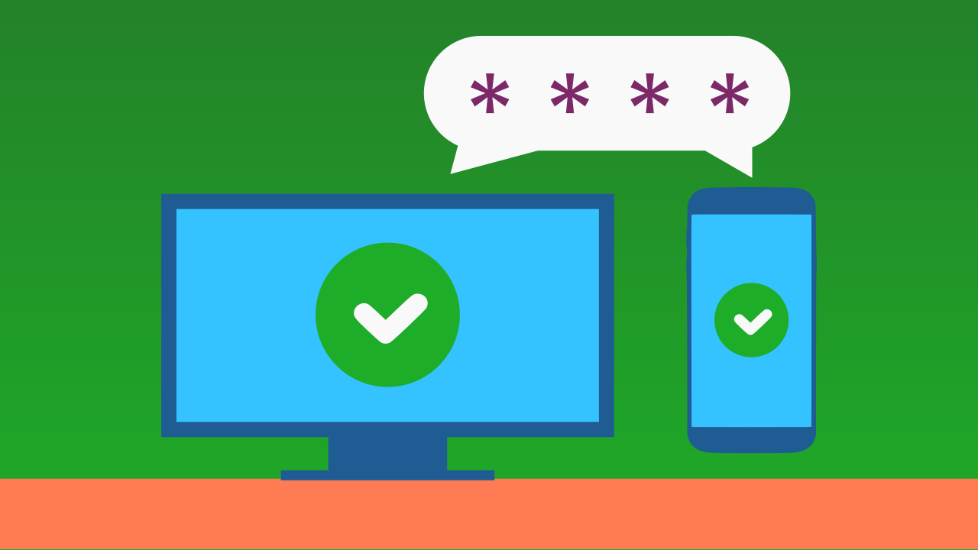
What if your password is stolen?
Even with a strong password, you need a backup plan. That's where Two-Factor Authentication (2FA) comes in. It’s like needing a second secret key. For example, after entering your password, a site might send a special code to your phone that you also have to enter. Without that second code, no one can get in, even if they know your password.

Slide 8
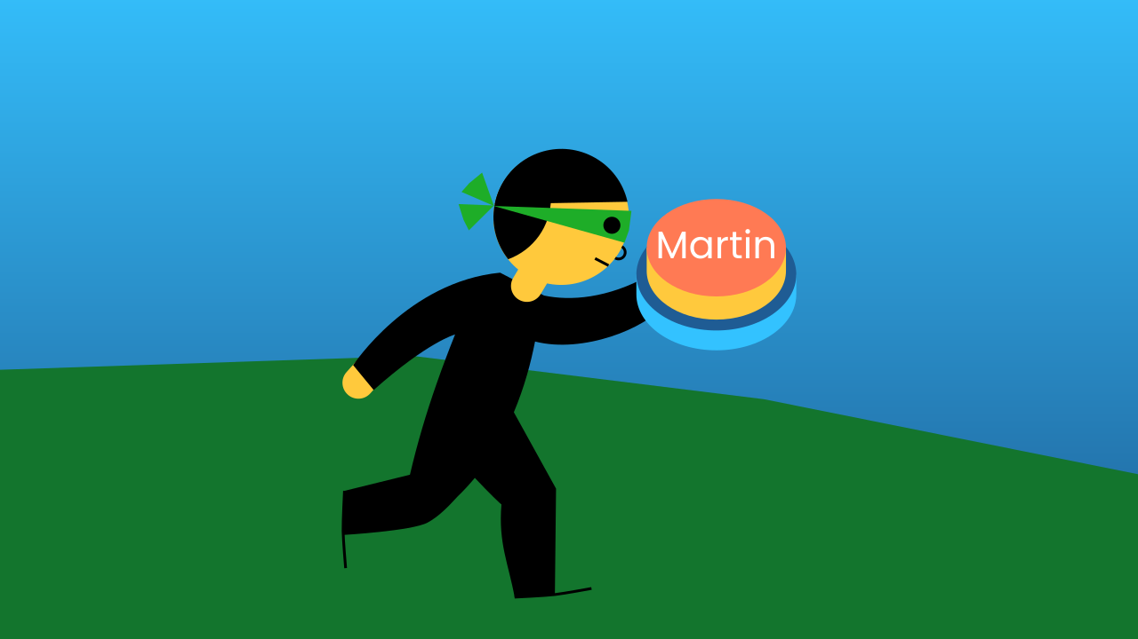
Our Two-Factor Safe!
The safe we’re building today uses the same 2FA principle. To turn off the alarm, you need two keys (our two buttons) to be pressed at the same time. If a thief steals Martin’s button, they still can’t deactivate the alarm without also having Juan’s button. This makes the treasure much safer!

Slide 9
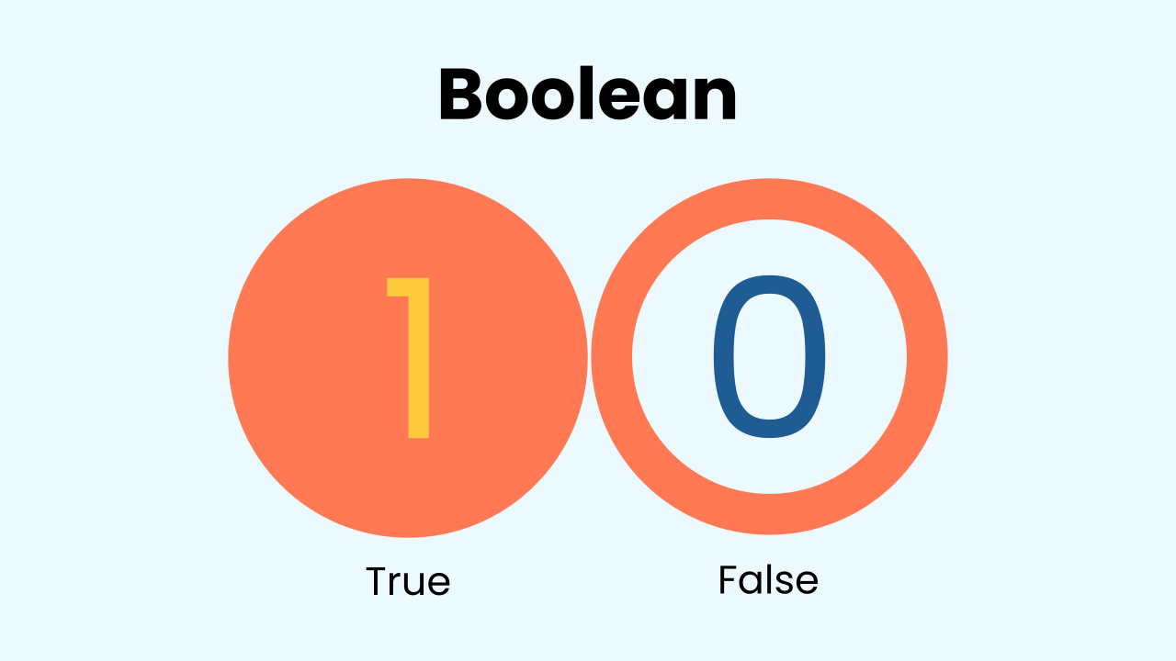
Booleans and The AND Operator
Remember that Booleans are a simple data type with only two possible values: TRUE or FALSE. When a button is pressed, its state could be TRUE. When it's not pressed, its state is FALSE.
The logical AND operator is like a strict bouncer who needs to see two forms of ID. It only returns TRUE if *all* the conditions it checks are true. If even one is false, the whole result is false.

Slide 10
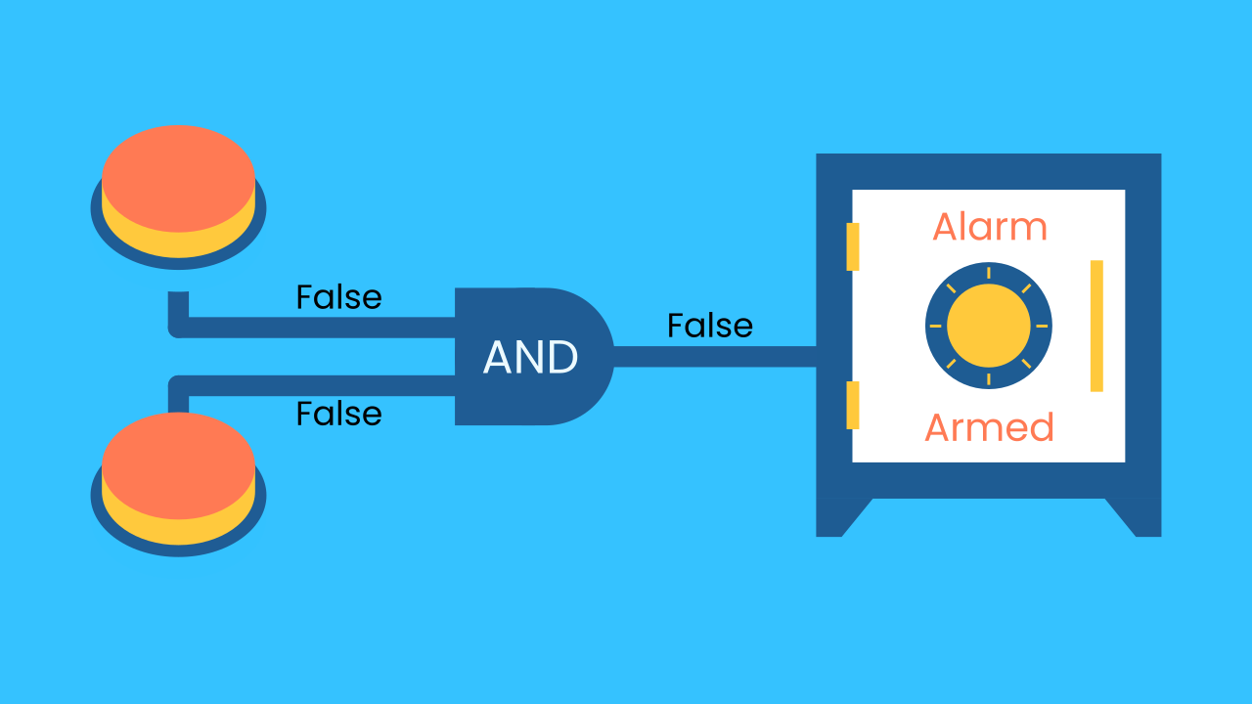
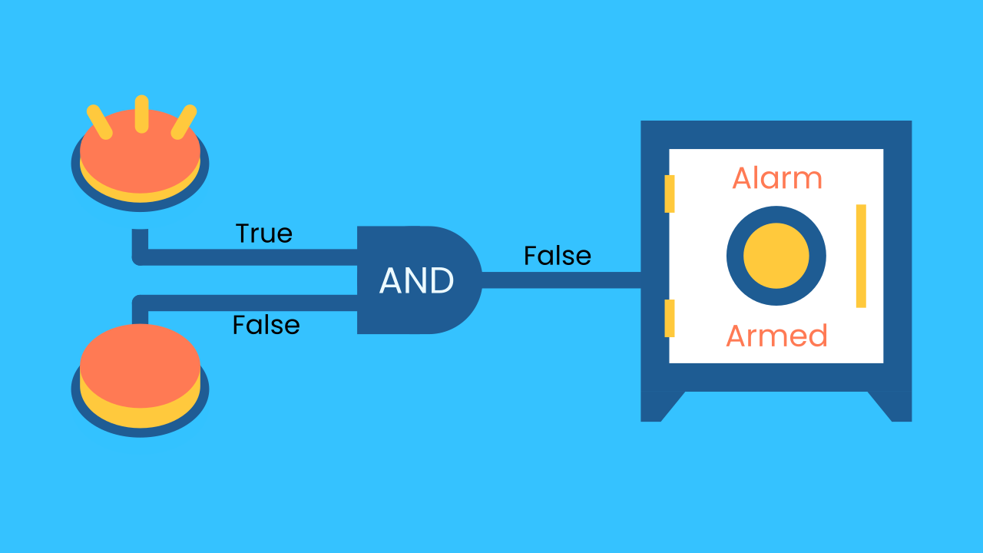

How AND Secures Our Box
Here's how the logic works for our safe:
If Button 1 is pressed (TRUE) AND Button 2 is pressed (TRUE) --> The result is TRUE, and the alarm is off.
If Button 1 is pressed (TRUE) AND Button 2 is NOT pressed (FALSE) --> The result is FALSE, and the alarm is active.
If neither is pressed, the result is also FALSE. Both keys are required at the same time!

Slide 11
Make the Safe Box
For this activity, we need 3 devices.
On the first device (the safe itself), add WriteDraw, Inclination, and AudioPlayer.
On the second device, add a TouchButton (this is Martin’s key).
On the third device, add another TouchButton (this is Juan’s key).

Slide 12
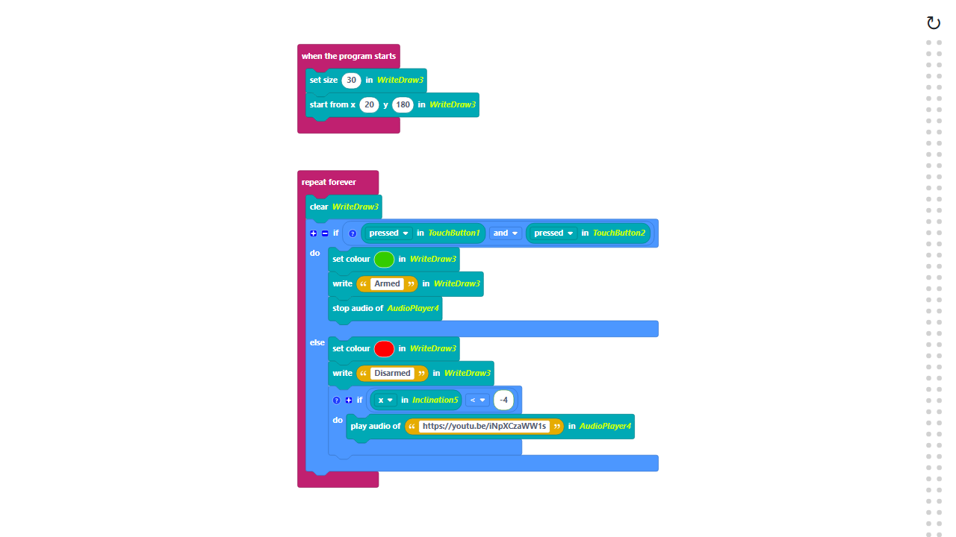
Code Composition
Click on the question mark icon to open comments that explain the code.
https://app.protobject.com/generate?a21-alarmbuttons&en&dynamic&-1

Slide 13
Reflect
Did you find this topic interesting? Cybersecurity is one of the fastest-growing and most important fields in technology. Is it something you could see yourself doing in the future?
What other methods do you know to protect your online accounts and data?

